Slide 1
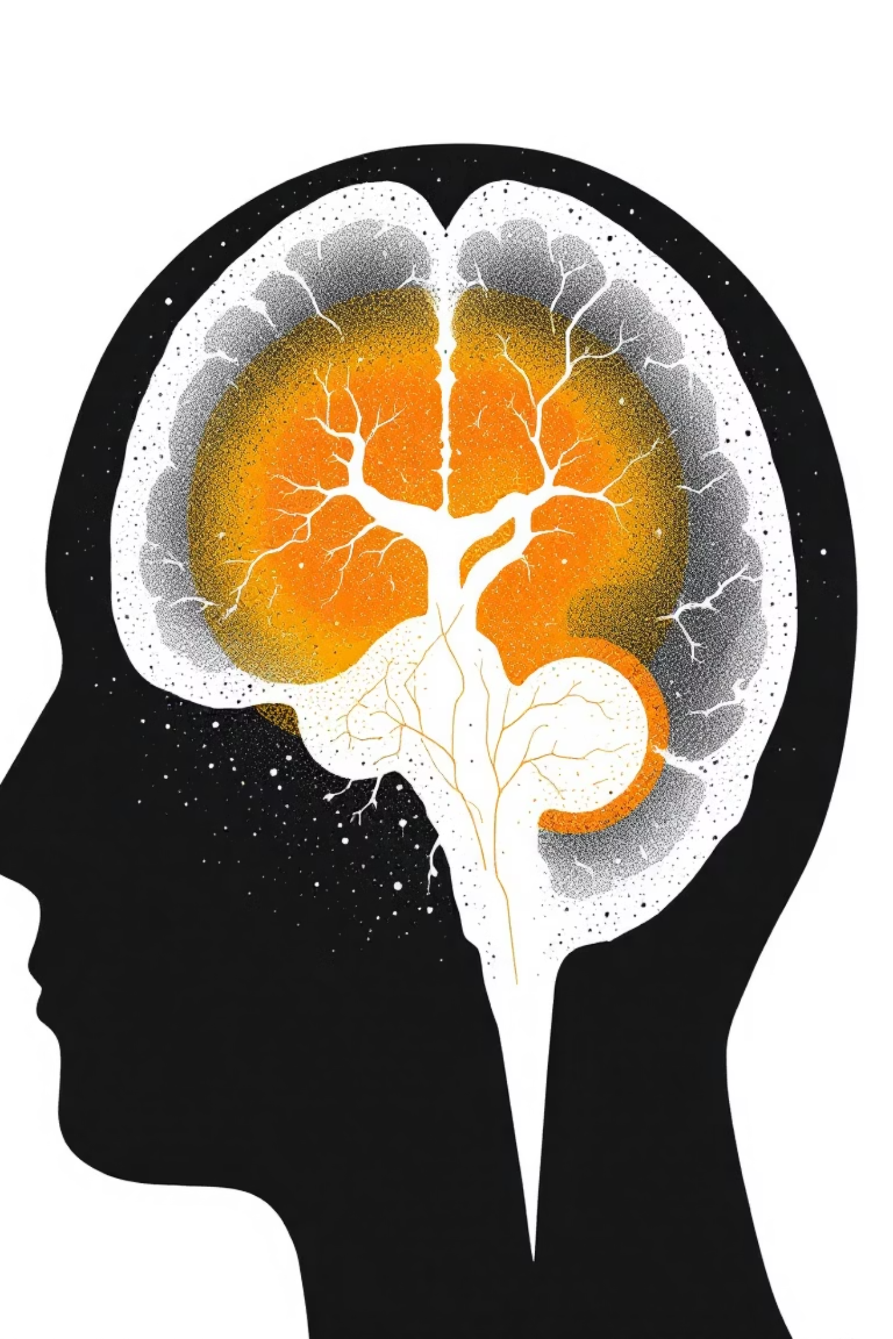
Introduction: Hit-or-Miss Transform for Tumor Detection
This presentation focuses on using the Hit-or-Miss Transform (HMT) to detect and analyze tumor structures, specifically meningioma tumors in axial MRI images. After segmentation, we obtain binary images where white pixels represent the tumor and black pixels represent the background.
To study tumor shape and structure, we utilize Morphological Operations. The Hit-or-Miss Transform is a powerful tool for finding specific patterns or shapes within these binary images, offering a precise method for tumor identification.
By-
1.BT23CSE224-Divit Srivastava 2.BT23CSE042-Athatva Khaire 3.BT23CSE039-Prathmesh Ghormare 4.BT23CSE034-Arnab Halder
5.BT23CSE182-Erukulla Raghunandan

Slide 2

Literature of Morphological Image Processing
Morphological Image Processing is widely used in medical image analysis. The Hit-or-Miss Transform (HMT), introduced by Jean Serra in 1982, is a fundamental yet powerful operation for detecting exact shapes in binary images.
Shape Recognition
Matches tumor morphology with high precision.
No Training Needed
Unlike AI methods, HMT requires no extensive training data.
Computationally Efficient
Offers fast processing for quick results.
Proven Effectiveness
Successfully applied in various medical imaging scenarios.

Slide 3
HMT Formula & Application
The Hit-or-Miss Transform (HMT) is a fundamental morphological operation designed to detect exact configurations of foreground and background pixels in a binary image. It achieves this precise pattern recognition through a combination of two erosion operations.
Where:
A: The input binary image.
B1: The 'hit' kernel, representing the foreground pattern to be detected.
B0: The 'miss' kernel, representing the background pattern surrounding the foreground.
Ac: The complement of the input image, where foreground becomes background and vice versa.
\ominus: The erosion operation, which shrinks the boundaries of foreground objects.
\cap: The intersection operation, combining the results of both erosions.
Preprocessing with Thresholding
Before applying the Hit-or-Miss Transform, it is crucial to convert any grayscale medical image into a binary format. This process, known as thresholding, is essential because HMT operates exclusively on binary images.
Converts a grayscale image into a binary image, where pixels are either pure black or pure white.
Ensures a clear and unambiguous separation between the object (e.g., tumor) and the background.
A prerequisite for HMT, as the transform relies on precise foreground and background definitions.

Slide 4

Hit-or-Miss Transform Basics
Hit Kernel
Miss Kernel
Erosion
This structuring element defines the specific foreground pattern we aim to detect.
This structuring element represents the desired background pattern surrounding the object.
A fundamental morphological operation that effectively shrinks objects in a binary image.
It 'hits' only where the object's shape perfectly matches.
It 'misses' detection if the surrounding area doesn't precisely match.
A pixel remains '1' only if the structuring element fits entirely.
Used to identify specific shapes or patterns in the foreground of a binary image.
Crucial for HMT, verifying if both hit and miss kernels fit exactly.
Ensures detection occurs only when the background structure is as expected.

Slide 5






System Model: HMT Step-by-Step
Our system model outlines a clear process for tumor detection using HMT, starting from the raw MRI scan to the final output of detected tumor patterns.
Input Image
MRI scan of the brain.
Preprocessing
Separation of foreground and background.
Segmentation
Isolating the meningioma tumor from axial MRI images.
Structuring Elements
We have used ellipse shaped image as structuring element.
Apply HMT
HMT(A)=(A⊖B1)∩(Ac⊖B2) to mark desired shapes.
Output
Detected tumor patterns: holes, edges and boundaries.

Slide 6
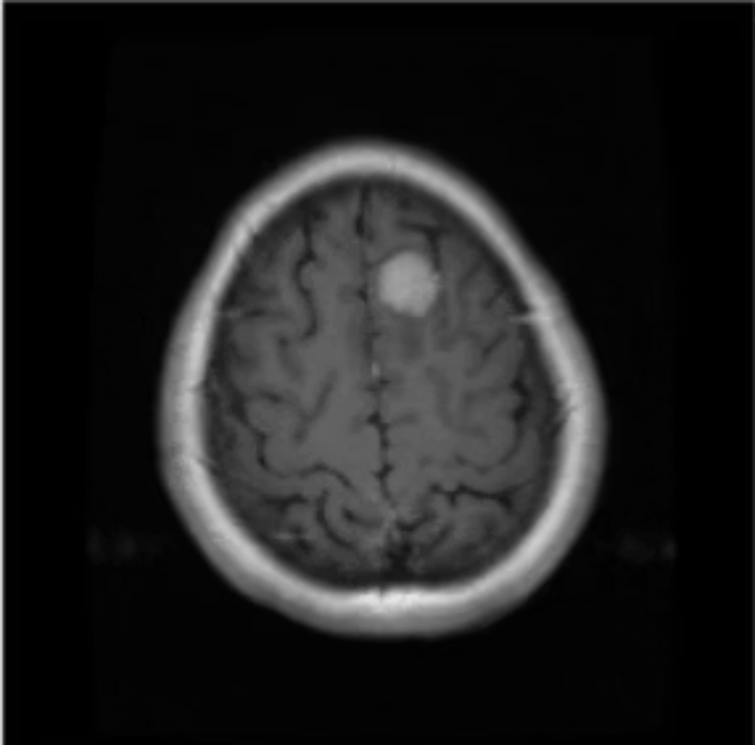
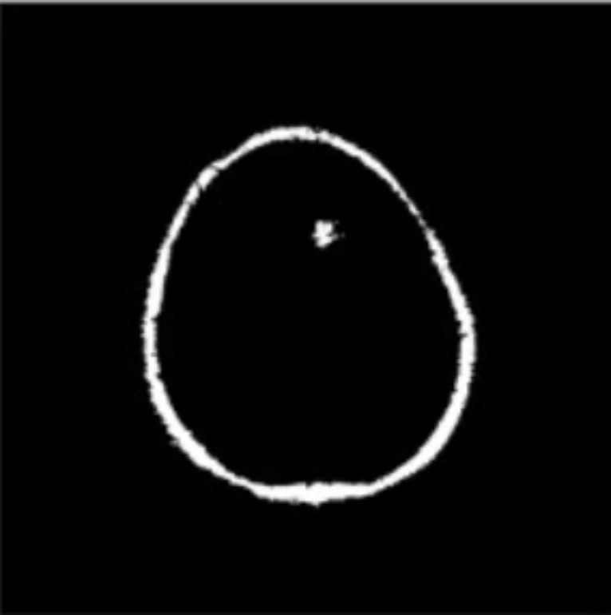

Observed Outputs: HMT in Action
The Hit-or-Miss Transform successfully detects tumor regions, providing crucial insights into their characteristics. This method is particularly effective in identifying boundary irregularities, which can be key indicators of malignant tumors.
HMT works well with binary MRI masks after segmentation, offering a robust approach to feature extraction. It provides shape-based features essential for further classification and analysis of tumor types.
Successfully detects tumor regions.
Identifies boundary irregularities.
Works with binary MRI masks.
Provides shape-based feature extraction.
Original Image
Structuring Element
Image after Erosion

Slide 7

Conclusion: HMT's Impact on Medical Imaging
The Hit-or-Miss Transform is a simple yet highly effective technique in medical image morphology. Its successful implementation for meningioma detection highlights its potential for automated diagnostic pipelines with minimal human intervention.
High Accuracy
Computationally Efficient
Automated Pipeline
Comparable to more complex methods.
Suitable for rapid clinical applications.
Reduces need for extensive manual input.
"HMT provides a robust, efficient foundation for automated brain tumor detection, balancing accuracy with computational practicality for clinical applications."

